Slide 1
Matthew 1:18-24
18This is how the birth of Jesus Christ came about: His mother Mary was pledged to be married to Joseph, but before they came together, she was found to be with child through the Holy Spirit. 19Because Joseph her husband was a righteous man and did not want to expose her to public disgrace, he had in mind to divorce her quietly. 20But after he had considered this, an angel of the Lord appeared to him in a dream and said, "Joseph son of David, do not be afraid to take Mary home as your wife, because what is conceived in her is from the Holy Spirit.

Slide 2
Matthew 1:18-24
21She will give birth to a son, and you are to give him the name Jesus, because he will save his people from their sins." 22All this took place to fulfill what the Lord had said through the prophet: 23"The virgin will be with child and will give birth to a son, and they will call him Immanuel" --which means, "God with us." 24When Joseph woke up, he did what the angel of the Lord had commanded him and took Mary home as his wife.

Slide 3
Matthew 2:13-15
13When they had gone, an angel of the Lord appeared to Joseph in a dream. "Get up," he said, "take the child and his mother and escape to Egypt. Stay there until I tell you, for Herod is going to search for the child to kill him." 14So he got up, took the child and his mother during the night and left for Egypt, 15where he stayed until the death of Herod. And so was fulfilled what the Lord had said through the prophet: "Out of Egypt I called my son."

Slide 4
Matthew 2:19-23
19After Herod died, an angel of the Lord appeared in a dream to Joseph in Egypt 20and said, "Get up, take the child and his mother and go to the land of Israel, for those who were trying to take the child's life are dead." 21So he got up, took the child and his mother and went to the land of Israel. 22But when he heard that Archelaus was reigning in Judea in place of his father Herod, he was afraid to go there. Having been warned in a dream, he withdrew to the district of Galilee, 23and he went and lived in a town called Nazareth. So was fulfilled what was said through the prophets: "He will be called a Nazarene."

Slide 5
Characters of Christmas
Ordinary People with Extraordinary Roles

Slide 6
Characters of Christmas Joseph
Ordinary People with Extraordinary Roles

Slide 7
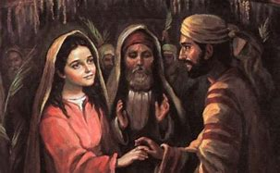
Joseph
Betrothed

Slide 8
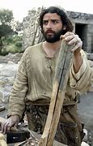
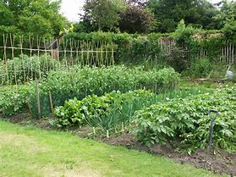
Joseph
Betrothed
Preparation

Slide 9
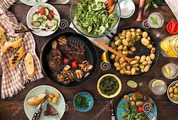
Joseph
Betrothed
Preparation
Wedding Feast

Slide 10
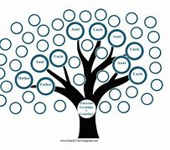
Joseph
Matthew 13:55 Carpenter
Matt 1:19-25 Righteous, Thoughtful
Son of David , Afraid,
Man of action
Mark 6:3 Father of 6 +

Slide 12
1 Nazareth to Bethlehem 100km around 7 days of travel
2-3 Twice they travelled to Jerusalem day 7 and day 40 after the birth 17km round trip
4 Left Bethlehem for Egypt 70 km journey
5 Returned from Egypt to Nazareth 170km

Slide 13
Joseph
Matthew 1:18-25
Do not divorce Mary

Slide 14
Joseph
Matthew 1:18-25
Do not divorce Mary
Matthew 2:13-14
Leave for Egypt

Slide 15
Joseph
3. Matthew 2:19-21
Return to Israel
Matthew 1:18-25
Do not divorce Mary
Matthew 2:13-14
Leave for Egypt

Slide 16
Joseph
3. Matthew 2:19-21
Return to Israel
Matthew 1:18-25
Do not divorce Mary
4. Matthew 2:22-23
Travel to Nazareth
Matthew 2:13-14
Leave for Egypt

Slide 17
Joseph
Unrest, corruption
Uncertainty
Pain
Character of Joseph seen in his actions
Ordinary person with an extraordinary role

Slide 18
Our world today
Unrest, corruption
Uncertainty
Pain
Is God speaking to you
Is God’s character seen in your actions

Slide 20
Where is God?

